Slide 1
The Weekend Navigator
Session 3
Underway Navigation

Slide 2
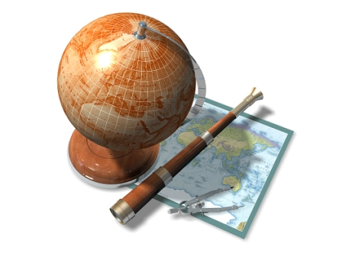
The Weekend Navigator
Cruise Problem #2 Review

Slide 4
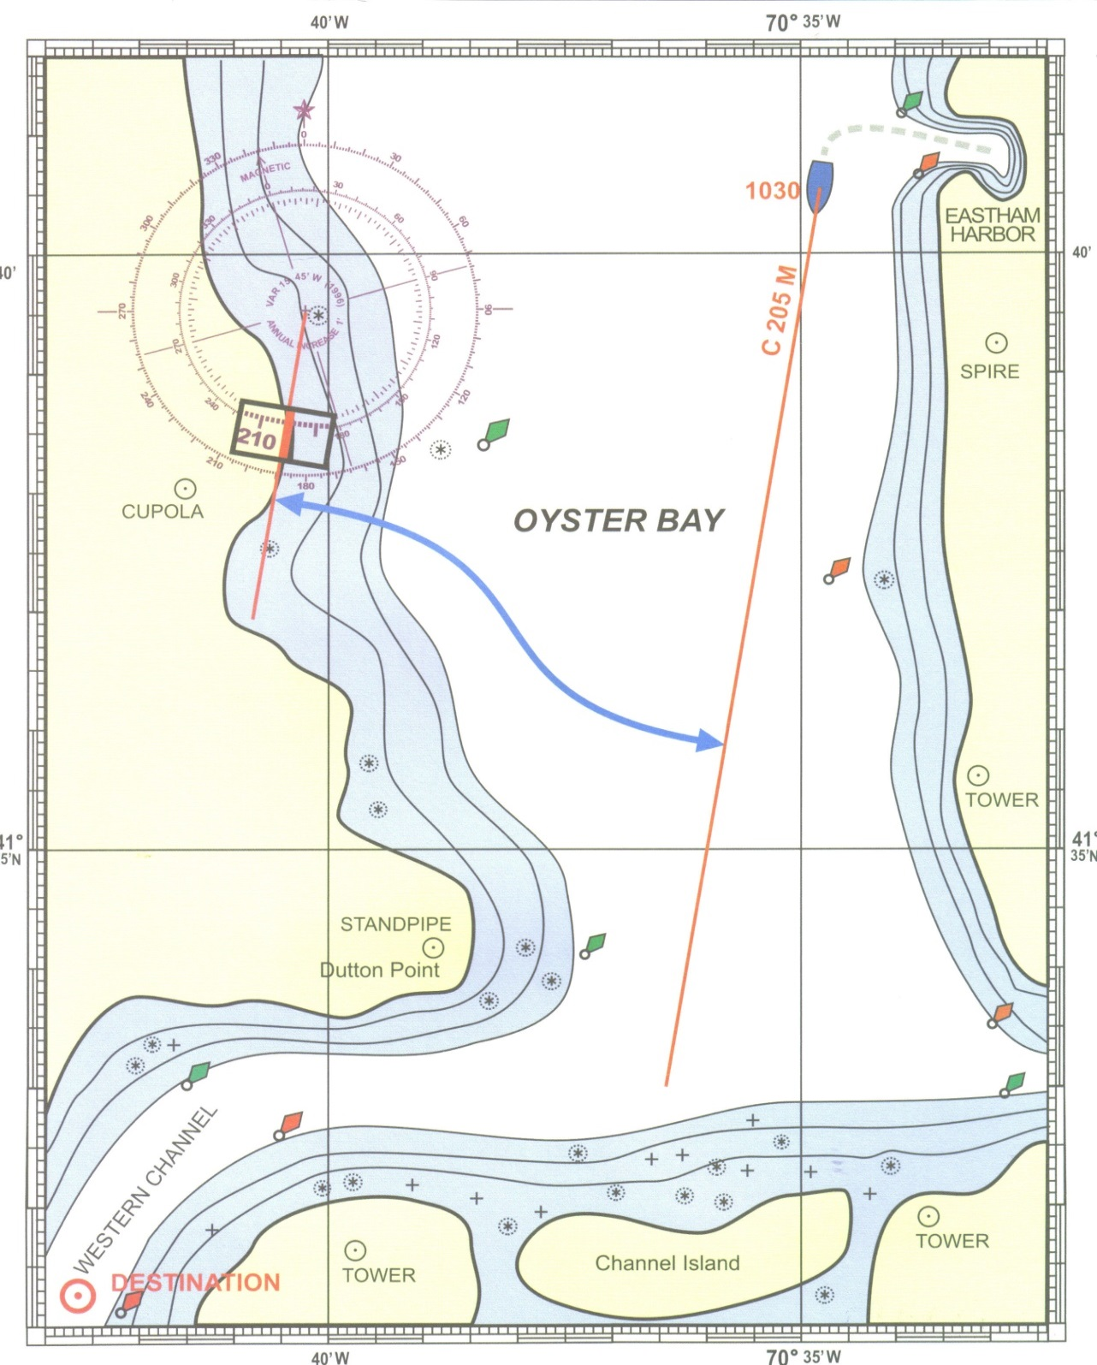
C 250 M
S 18.0
1044
S 18.0
C 187 M
1059
S 10.0
C 197 M
1120
C 283 M
1105
WPT TURN
S 12.0
C 233 M
S 12.0
1140
Notes:
Review Cruise Exercise #2 results. DR position symbols left off to reduce clutter. Distance entries may be shown—navigator’s choice.

Slide 5
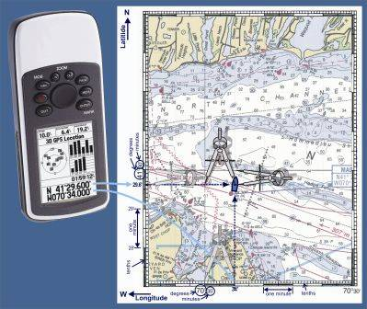
The Weekend Navigator
Underway with Paper Charts
Fig 8-15
Notes:
GPS is addresses first, then paper charts.

Slide 6
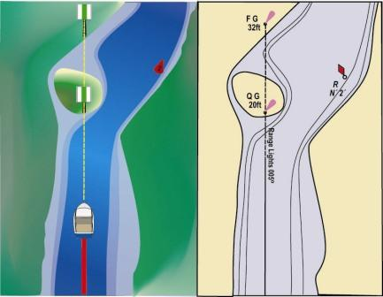
Correcting for Variation & Deviation
Compass reads 018° but Range plots as 005° T
. . . What Gives?
Fig 2-12
Notes:
This and the next slide Introduce TVMDC + W. While the text uses M for all measurements, some students will have seen this in traditional navigation lessons.
The text doesn't use the traditional term “uncorrecting,” but instead refers to all adjustments for variation and deviation, whether going from T to C or C to T as “correcting.”
Using the variation shown on Chart 1, rounded to 016° W.

Slide 7
Correcting for Variation & Deviation
START
Tele-
T
True Bearing 005°
Vision
V
Variation 016° W
Makes
M
Magnetic Bearing 021°
DOWN
ADD
WEST
Dull
D
Deviation 003° E
Children
C
Compass Bearing 018°
Add Wonder (Add West)
Notes:
Traditional navigation memory device, taken from the BS&S course, Chapter 9.
This applies to Bearings, Headings, or Courses.

Slide 8
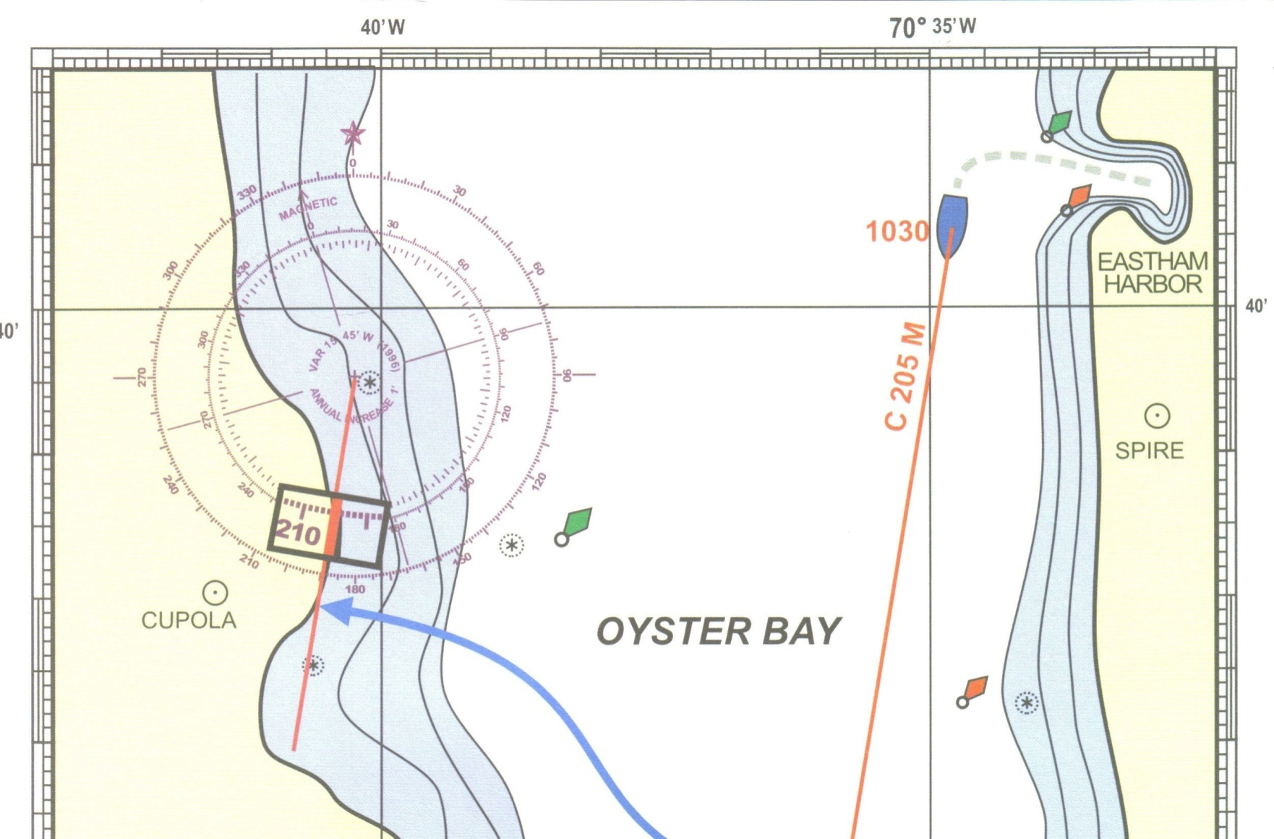
Class Exercise-Taking Bearings
What is the M bearing (taken with a hand bearing compass) from the blue boat to the copula? Label it as an LOP
1030
260 M
Notes:
Use Chart 1

Slide 9
Class Exercise-Taking Bearings
If the boat is pointed at the copula, what will the compass read? Compass deviation is 007° W on that heading.
M
Magnetic Bearing 260°
D
Deviation 007° W
C
Ship’s Compass Bearing 267°
Notes:
Assume that the handheld compass was at a different location than the ships compass, so the handheld had no deviation

Slide 10
Class Exercise-Fixs
Use Chart 2
Your GPS is on the fritz! At 1312, you take a ship’s compass bearing on the the Standpipe by pointing the boat at it. What is the M bearing? What is your Lat. / Long.?
The Standpipe at Nobska Pt bears 330° C. Your Deviation Table gives 004° W deviation on this heading.

Slide 11
Class Exercise
Standpipe
M
326°
D
004° W
C
330°
Can’t determine position with only one LOP

Slide 12
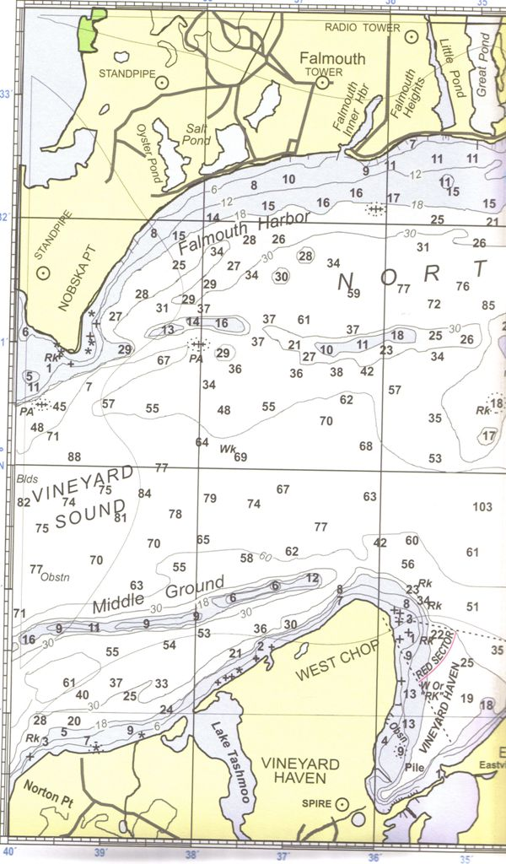
1312
326 M
Notes:
Graphical solution to the exercise. We’ll use this fix during Session 4.

Slide 13
Class Exercise-Fixs
Use Chart 2
At 1312, you also take a ship’s compass bearing on the Radio Tower by pointing the boat at it. What is the M bearing and what is your Lat. / Long.?
The Radio Tower at Falmouth Heights bears 022° C. The deviation on this heading is 003° E.

Slide 14
Class Exercise
Radio Tower
M
025°
D
003° E
C
022°
41° 29.7’ N 070° 36.5’ W

Slide 15
1312
025 M
1312
326 M
1312
Notes:
Graphical solution to the exercise. We’ll use this fix during Session 4.

Slide 16
The Weekend Navigator
Underway with GPS
Fig 8-15

Slide 17
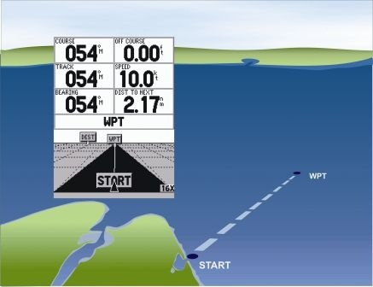
Steps in Waypoint Navigation
Select and activate the waypoint
Double check that you have a pre-qualified path
Steer to the direction
on the GPS
Fig 8-3
Notes:
The Highway page shown is very useful for the helmsman.
Waypoint is selected from a listing or a map screen

Slide 18
Steps in Waypoint Navigation
Monitor your progress
Be alert as you approach your destination
Select and activate the next waypoint
Be careful with your numbers!
Notes:
Double check waypoint entries and keep situational awareness.

Slide 19
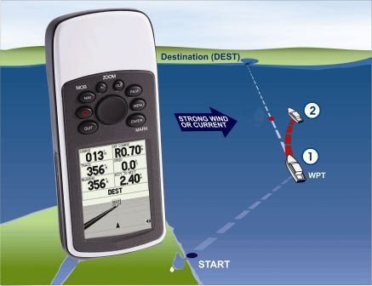
Staying on Course
Reasons why you may wander off course
Steering to avoid visible obstacles
Your boat yawing in waves
Inattention at the helm
Crosswinds
Crosscurrent
Fig 8-12

Slide 20
Staying on Course
How can I use a non-mapping GPS to tell where I am?
Plot the Lat./Long. coordinates
Bearing and distance to a waypoint
Monitor GPS data. See page 101.
Use Map or Highway Screen
Keep a “proper look-out”
Notes:
Page 101. Briefly discuss data that can be monitored underway.

Slide 21
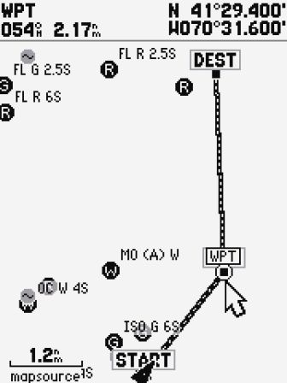
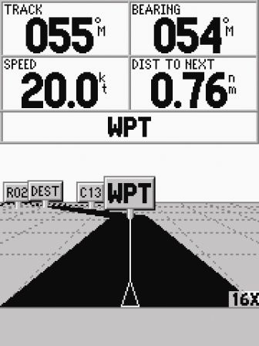
Staying on Course
Highway Screen may be easier to use
Stay in the center of the highway and “oversteer” to return to the center line

Slide 22
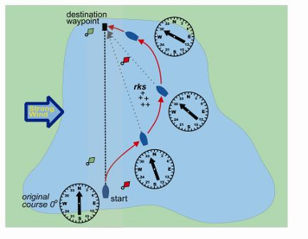
Staying on Course
GPS or Not: Effects of wind or current
Pushes away from intended course
Can be a curved path instead of the straight course to destination
Check position before going directly for the destination
Sailing vessels- greater effect
Fig 8-19
Notes:
Introduced the term Trackline

Slide 23
Staying on Course
Actual track is at an angle downwind or “down current”
The solution is to head upwind or “up current” and “Crab” along your course line
Fig 8-22

Slide 24
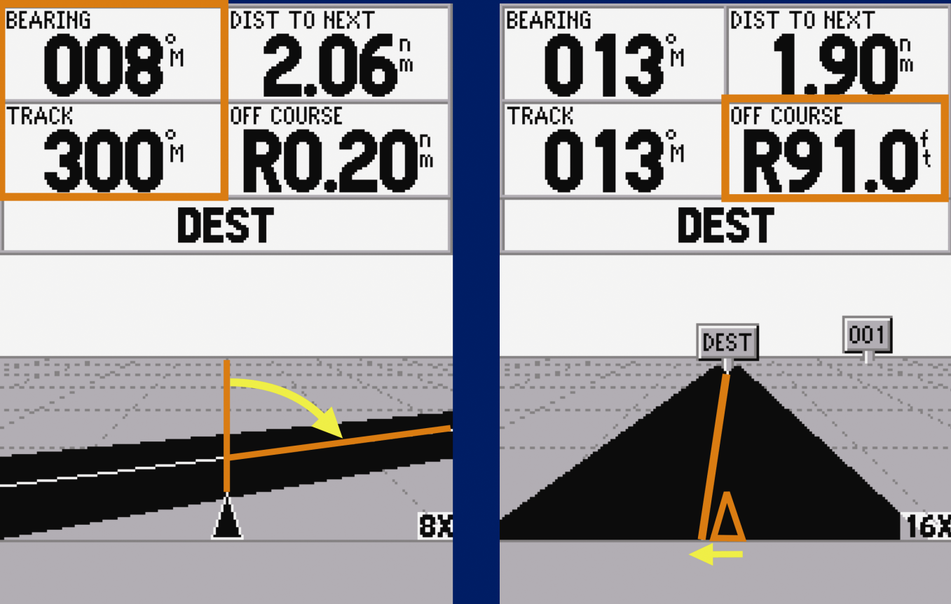
Staying on Course
Cross-track error (XTE, XTK, or “off course”): The distance that you are off course either to port (L) or starboard (R) in nm or ft.
Fig 8-26
Notes:
“Off Course” reading in nm or ft depending on how far the vessel is from the intended course line.

Slide 25
Sailors Tacking Decisions
Useful for tacking decisions
Set start and destination waypoints
Set limits on cross track error

Slide 26
Navigating in a Region
Make use of the map screen when navigating casually (i.e., not on a route or going to a WPT)
Set your zoom level to correspond with your speed
Don’t “outrun” your GPS
Notes:
The map screen can be used exclusively for an entire trip. It invited watching the GPS screen too much. Invites neglecting watching the helm.

Slide 27
Marking Objects
Avoid dependence on Private ATONS
Set waypoints to avoid hazards
Set waypoints at landmarks and use for bearings
Notes:
Danger bearings and circles are addressed in Session 4.
The next topic is using bearings for keeping track & double-checking

Slide 28
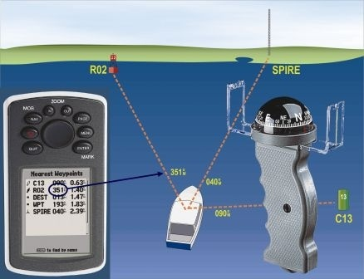
Keeping Track & Double-Checking
Fig 10-3

Slide 29
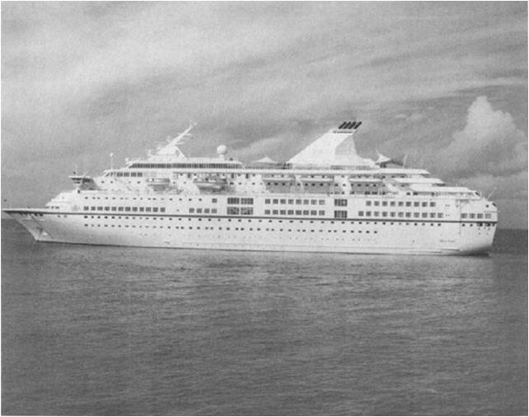
THE ROYAL MAJESTY, JUNE 9, 1995
Notes:
The complete 75 page NTSB report is available on the internet. PB97-916401, NTSB/MAR-97/0l
The Royal Majesty departed Bermuda enroute to Boston on June 9, 1995, with 1509 persons on board. Just prior to departure, a repairman damaged the cable between the GPS antenna and the receiver, interrupting the signal. Nobody noticed that the GPS wasn’t working. The ship was continuously steered by the autopilot using DR data from the GPS, not waypoint data. The bridge crew completely relied on the GPS, without backing it up with traditional navigation techniques. She ran aground the next morning, about 17 miles off course. No injuries, but $7 million in damages and lost revenue.

Slide 30
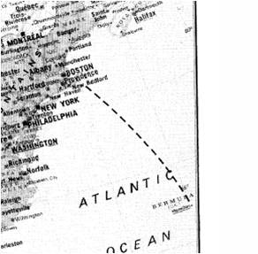
Notes:
Planned course.

Slide 31
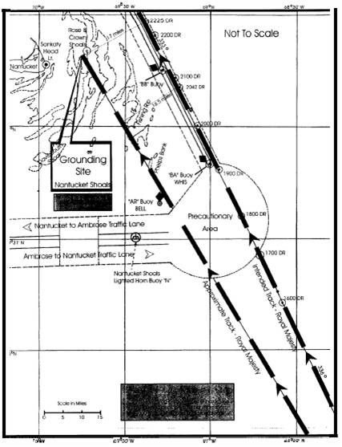
Notes:
Intended track vice actual track.

Slide 32
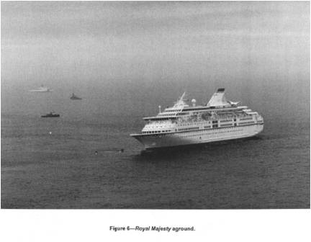
Notes:
No injuries. $7 million in damage to vessel and lost revenue.
GPS antenna disconnected. Backup systems were ignored

Slide 33
Keeping Track & Double-Checking
What’s the use for Bearings?
Quick Observations
Habitually identify ATONs and landmarks
Take bearings using the ship’s compass
Remember to apply deviation!
Result is a magnetic bearing
Easy to compare with GPS
Periodically plot your quick bearings on a chart
Notes:
Keeping track and double checking isn’t a one time event, but is a process that’s fundamental to all navigation actions underway.
Information regarding the cruise ship Royal Majesty is presented in the “Additional Slides” following the end of the presentation.

Slide 34
Keeping Track & Double-Checking
Compare visual bearings with GPS
Plot your GPS location on a chart from time to time
In open waters, once an hour is adequate
More frequently at high speed, dangerous water, or in bad weather

Slide 35
Planning As You Go with GPS
Figure out where you are
Location along an active leg
Bearing to a landmark
Using a grid line
Using a waypoint
Plot a safe path to the new destination

Slide 36
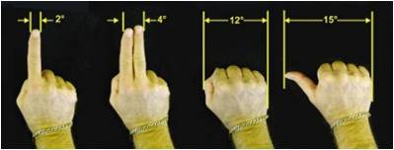
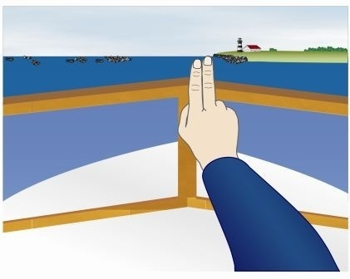
ESTIMATE DISTANCE
It’s all in the hands
Helps provide a mean to approximate angular difference
Offset from direct heading
Used when you can not find a suitable landmark that lines up with your heading

Slide 37
Collision Bearings
Use relative bearings to anticipate a collision
Constant bearing, decreasing range – watch out!!
Know the rules of the road- take appropriate action

Slide 38
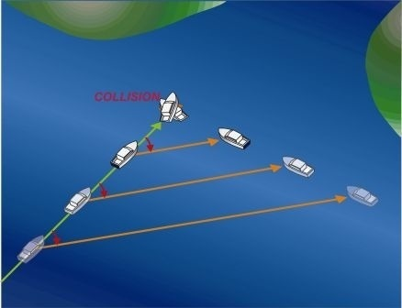
Collision Bearings
Fig 11-10

Slide 39
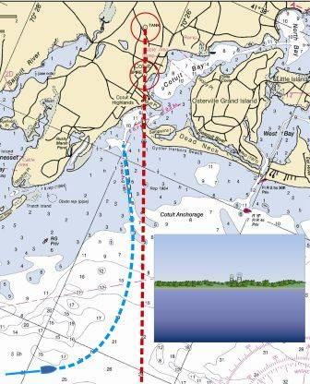
What To Do If the GPS Quits
Notes:
May not realize the GPS has quit or is in error unless the navigator is Double Checking.

Slide 40
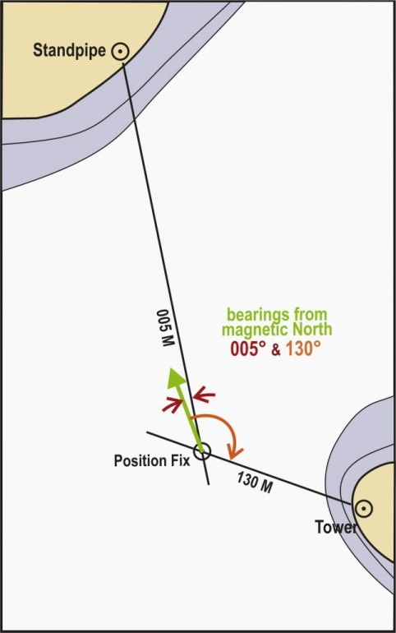
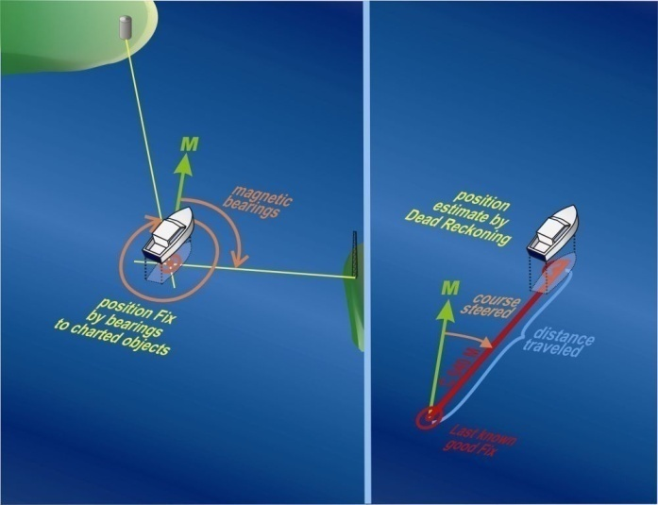
Stop and Regroup
Find your location
Use landmarks or ATONs
Use LOPs to get a fix
Use a backup GPS
Fig 12-1
Fig 12-2

Slide 41
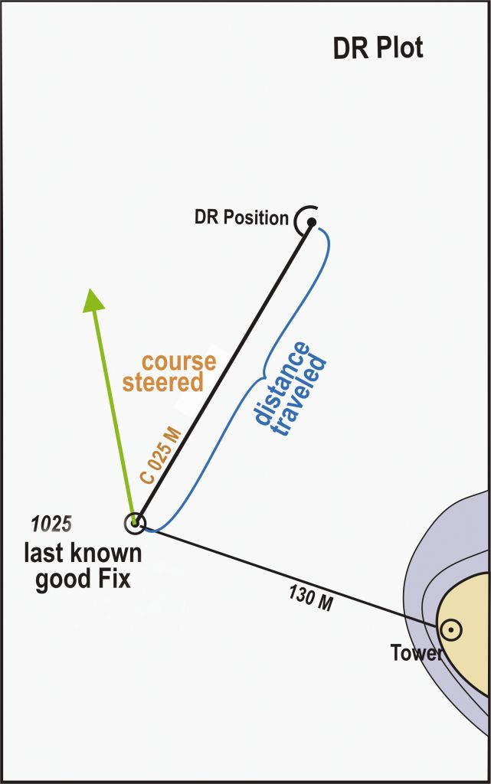
Stop and Regroup
Other alternatives to finding position
Reconstruct DR plot
Depth and depth profile
Radar
Fig 12-3

Slide 42
Plan Before Proceeding
Plot your best estimate on your chart
Examine your charted path for hazards
Be prepared to seek alternative routes
Be Careful with the numbers!
Notes:
Nearly 100% of navigation errors underway are due to carelessness.

Slide 43
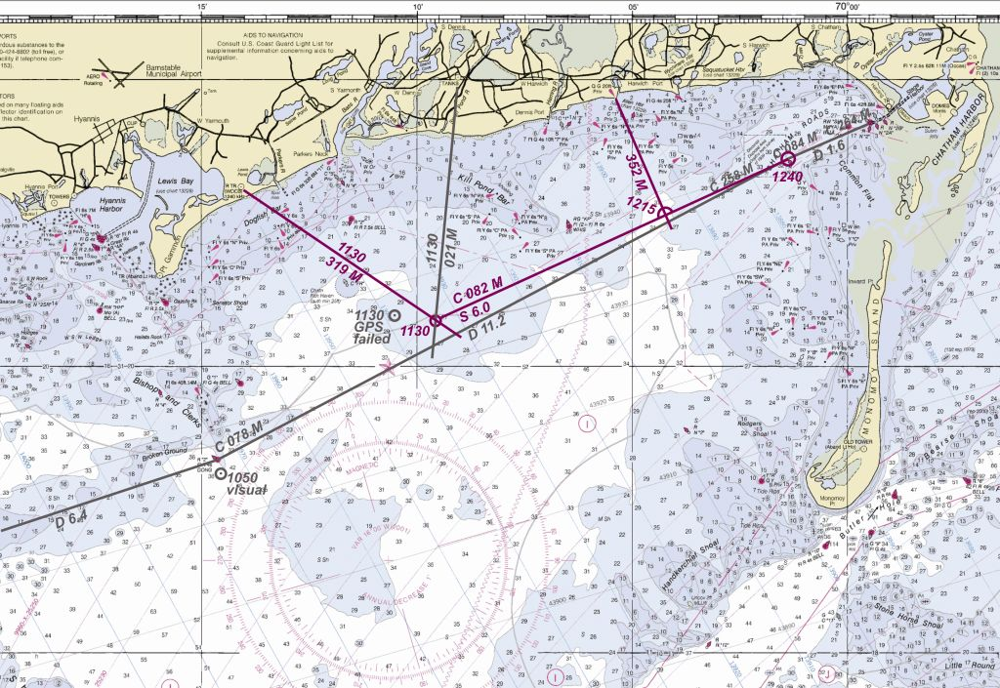
Navigating without GPS
Work-up a quick DR plot
Update your position from time to time using DR, Landmarks, and fixes
Fig 12-6

Slide 44
The Weekend Navigator
Homework for Session 4
Chapters 14-15

Slide 45
The Weekend Navigator
Additional Slides

Slide 46
The Weekend Navigator
End Additional Slides

